Slide 1

Database Management System
Cornerstone Project
Bank Account Management System
Presented by
S. NIKHIL(25B11AIA57)
V. LAKSHMI KARTHIK(25B11AIC38)
T. MANISH KOUSHIK(25B11AIB71)
CH. VINAY KUMAR(25B11AI225)
Department of
Artificial Intelligence and Machine Learning
GUIDED BY
V.G.L.NARSAMBHA

Slide 2

Presentation Overview
PHASE I
PHASE II
PHASE III
• Abstract
• Introduction
• Problem Statement
• Objectives
• System Analysis
• Database Design
• Tools & Technologies
• Entities & Attributes
• Relationships
• ER Diagram
• Relational Schema
• Expected Outcome
2

Slide 3
Abstract
Bank Account Management System
The Bank Account Management System is a relational database model designed to organize core banking records in a single, connected structure. It maintains customer information and links customers with accounts, beneficiaries and loans, while accounts are connected to branches, cards and transaction history. The model also records loan payments and supports branch-level employee information.
The database uses primary keys to uniquely identify records and foreign keys to preserve relationships between tables. This design helps reduce duplicate information, improves consistency between related records and makes banking data easier to store, retrieve and maintain.
KEY PURPOSE
Centralized records • Relationship integrity • Traceable transactions • Structured banking data
3

Slide 4
Introduction
Why a structured banking database?
• Banking operations generate interconnected customer, account and financial records.
• A relational model keeps these records connected through defined keys and relationships.
• The system brings customer, account, branch, transaction, loan, card and beneficiary data into one model.
Customer
Personal & KYC data
↓
Account
Account & balance data
↓
Transactions
Activity history
↓
Database
Related records
4

Slide 5
Problem Statement & Objectives
PROBLEM STATEMENT
OBJECTIVES
• Duplicate or inconsistent customer and account information.
• Difficulty maintaining links between accounts, transactions and other banking records.
• Limited traceability when transaction, loan and payment records are separated.
• Increased risk of data-entry errors when relationships are not enforced.
• Design a connected relational database for banking records.
• Use primary and foreign keys to maintain referential integrity.
• Organize transaction, loan, payment, card and beneficiary information.
• Make records easier to manage, retrieve and maintain.
5

Slide 6
System Analysis
CUSTOMER MANAGEMENT
ACCOUNT OPERATIONS
FINANCIAL RECORDS
• Customer profile
• Contact & identification data
• KYC status
• Account details
• Account type & branch
• Balance & status
• Transactions
• Loans & payments
• Cards & beneficiaries
6

Slide 7
Database Design
Relational design principles used in the project
Primary Keys
Uniquely identify each record in a table.
Foreign Keys
Connect related records across tables.
Relationships
Represent customer, account, branch, loan and transaction dependencies.
Data Integrity
Keep linked records consistent and reduce duplication.
7

Slide 8
Tools & Technologies
MySQL
ER Modeling
GitHub
Relational database implementation, tables, constraints and SQL queries.
Used to define entities, attributes, keys and relationships.
Repository management, version control and team collaboration.
8

Slide 9
Entities & Attributes
Customer
Account
Branch
Customer_ID, Customer_Name, Phone, Email
Account_ID, Customer_ID, Account_Number, Balance
Branch_ID, Branch_Name, IFSC_Code
Employee
Transaction
Loan
Employee_ID, Branch_ID, Employee_Name
Transaction_ID, Account_ID, Amount, Transaction_Date
Loan_ID, Customer_ID, Loan_Amount, Status
Payment
Card
Beneficiary
Payment_ID, Loan_ID, Amount, Payment_Date
Card_ID, Account_ID, Card_Number, Status
Beneficiary_ID, Customer_ID, Account_Number
PK = Primary Key | FK = Foreign Key
9

Slide 10
Relationships & Cardinality
Customer → Account
One customer can have multiple accounts.
1 : M
Account → Transaction
An account can have many transactions.
1 : M
Branch → Employee
A branch manages multiple employees.
1 : M
Customer → Loan
A customer may have multiple loans.
1 : M
Loan → Payment
A loan can have multiple payments.
1 : M
Customer → Beneficiary
A customer can register multiple beneficiaries.
1 : M
10

Slide 11
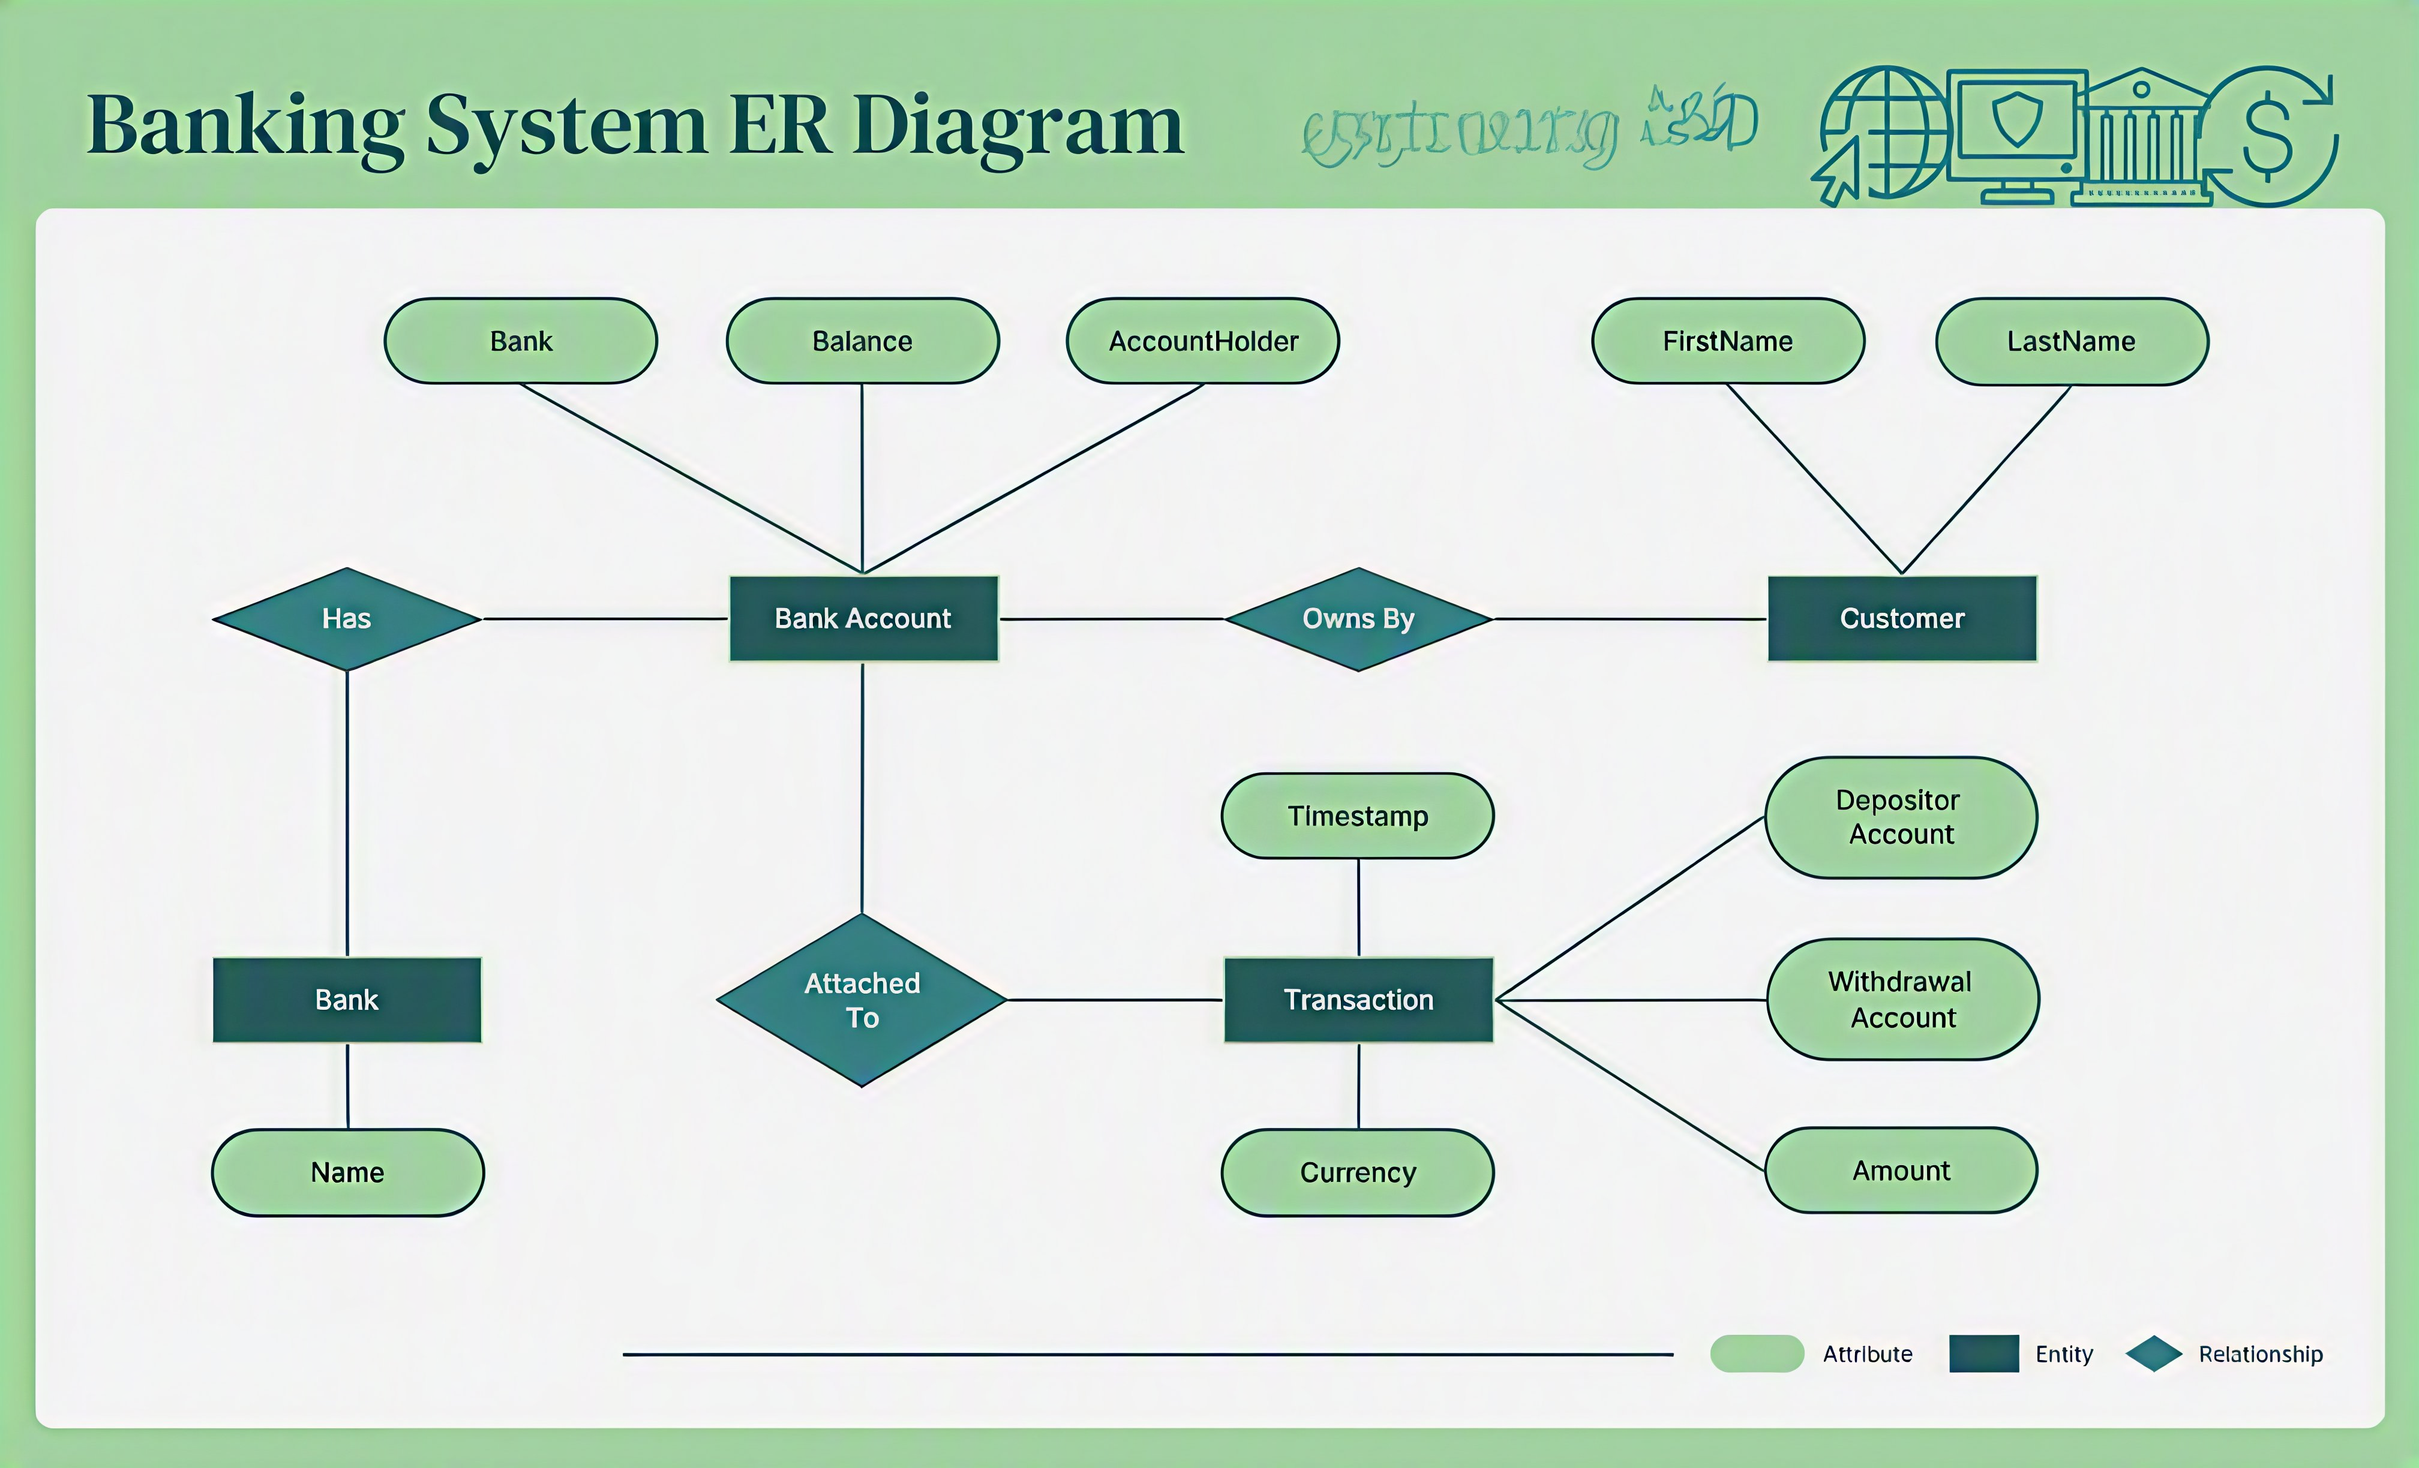
ER Diagram
11

Slide 12
GitHub Repository
Bank Account Management System
GitHub Repository:
https://github.com/chandandas27/Bank-Management-System
Repository Contents:
JavaFX-based banking application
MySQL database
ER Diagram
SQL database file
Customer & account management
Transaction management
Banking services
Branch & employee management
Technologies
JavaFX | MySQL | NetBeans | SQL | ER Modeling
Repository:
View GitHub Repository

Slide 13
Relational Schema
CUSTOMERS
ACCOUNTS
BRANCHES
Customer_ID (PK)
Customer_Name
Phone
Email
KYC_Status
Account_ID (PK)
Customer_ID (FK)
Branch_ID (FK)
Account_Number
Balance
Branch_ID (PK)
Branch_Name
IFSC_Code
City
TRANSACTIONS
LOANS
PAYMENTS
Transaction_ID (PK)
Account_ID (FK)
Transaction_Date
Amount
Loan_ID (PK)
Customer_ID (FK)
Loan_Amount
Interest_Rate
Status
Payment_ID (PK)
Loan_ID (FK)
Payment_Date
Amount
CARDS
BENEFICIARIES
EMPLOYEES
Card_ID (PK)
Account_ID (FK)
Card_Number
Card_Type
Status
Beneficiary_ID (PK)
Customer_ID (FK)
Account_Number
IFSC_Code
Employee_ID (PK)
Branch_ID (FK)
Employee_Name
Designation
12

Slide 14
Expected Outcome
Expected result of the database model
• Centralized storage of core banking records.
• Consistent relationships between customers, accounts and related entities.
• Clear tracking of transactions, loans and payments.
• Structured access to branch, employee, card and beneficiary information.
DATABASE VALUE
Accuracy
Consistency
Traceability
Maintainability
13

Slide 15
Thank You
Thank You
Bank Account Management System
Questions & Discussion
14

